Slide 1

WAY TO ENTERPRISE
AWS
VTI ACADEMY
Author: duy.nguyenngoc1@vti.com.vn

Slide 2
Agenda
CloudWatch Service
CloudTrail Service
AWS Config Service
Assignments
Quiz
Copyright © VTI Academy All Rights Reserved

Slide 3
Monitoring & Audit Service
CloudWatch Service
CloudTrail Service
AWS Config Service

Slide 4
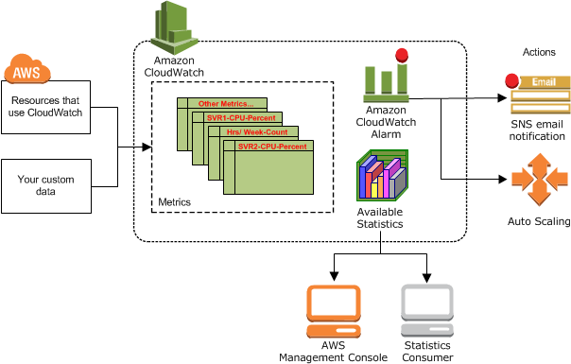
CloudWatch Service
Provides metrics for every services in AWS (Ex: CPUUtilization, NetworkIn, …)
AWS services that publish CloudWatch metrics
https://docs.aws.amazon.com/AmazonCloudWatch/latest/monitoring/aws-services-cloudwatch-metrics.html
Price: https://aws.amazon.com/cloudwatch/pricing
https://docs.aws.amazon.com/AmazonCloudWatch/latest/monitoring/WhatIsCloudWatch.html

Slide 5
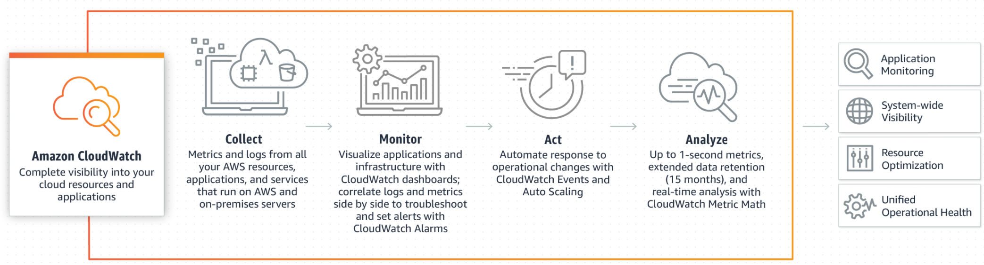
CloudWatch Service
Demo
Launch EC2 instance
Connect to instance & Using CPU
View EC2 Statistics via CloudWatch Console
Create Alarm
Create Dashboard

Slide 6
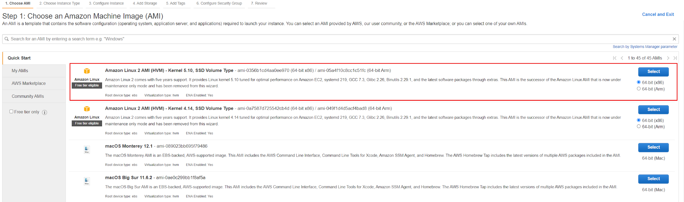
CloudWatch Service
Launch EC2 instance

Slide 7
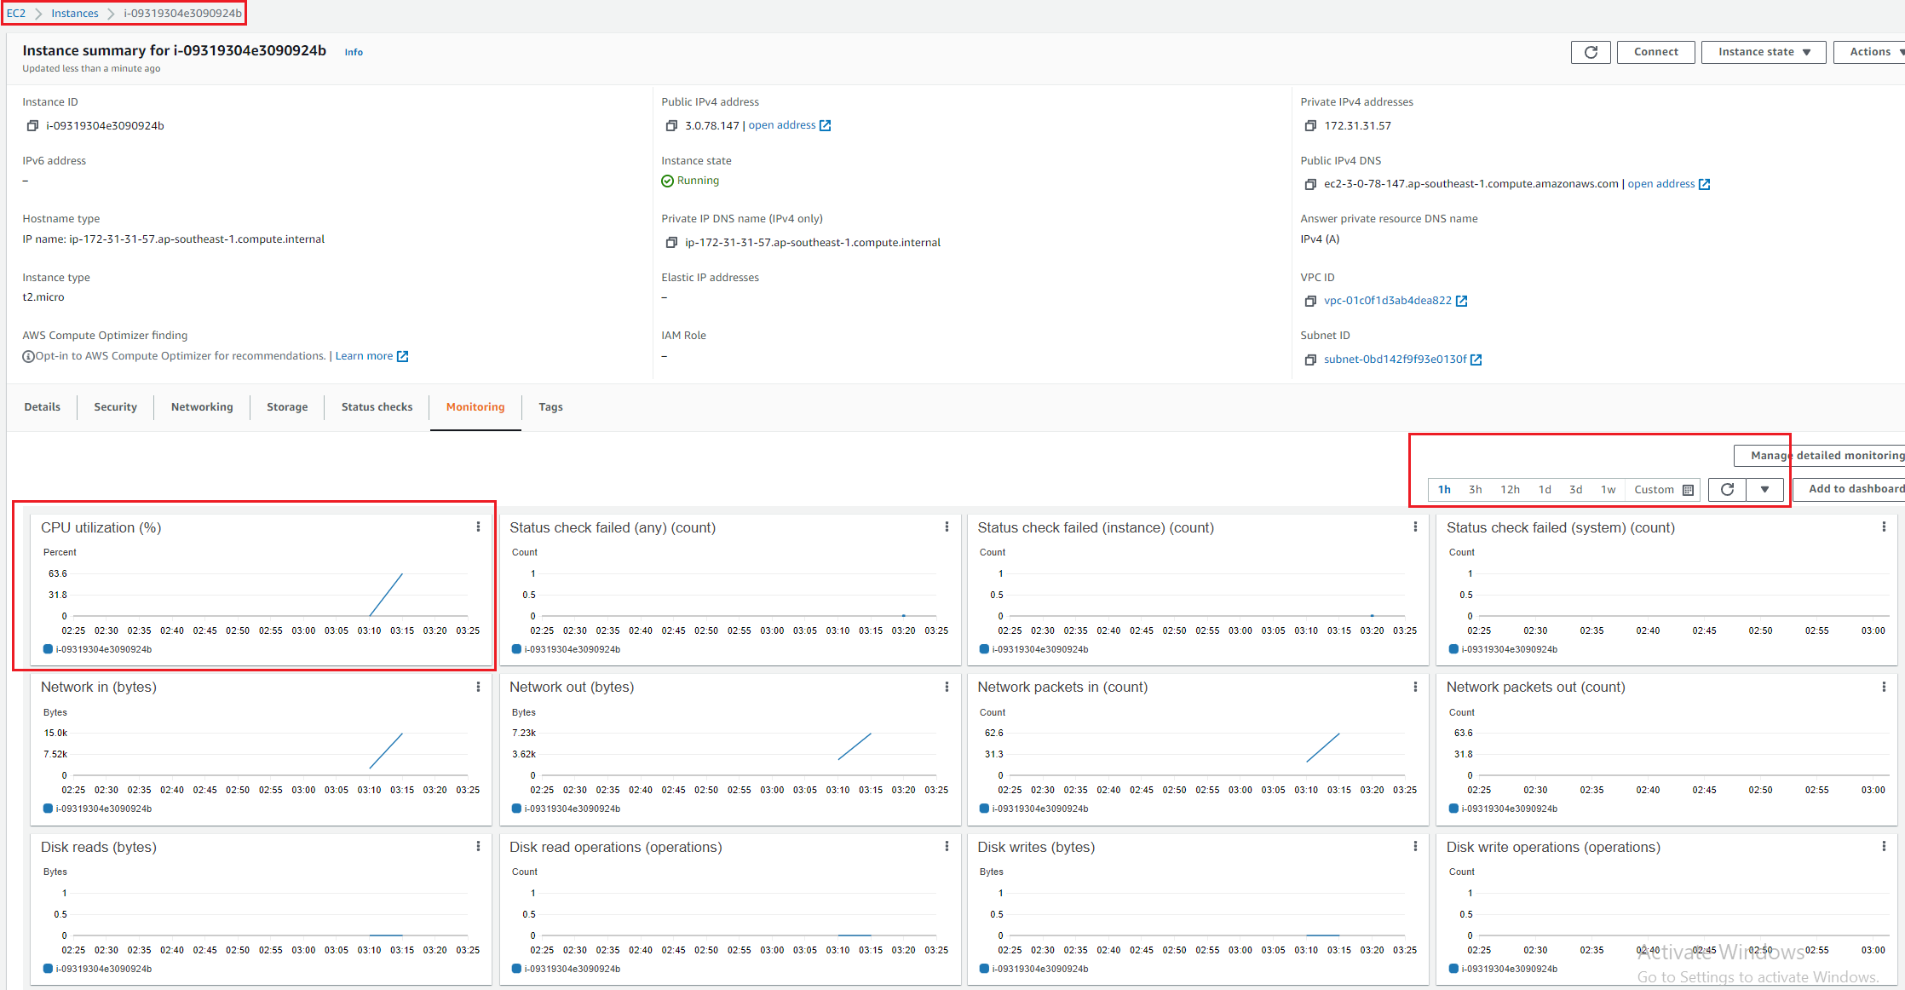
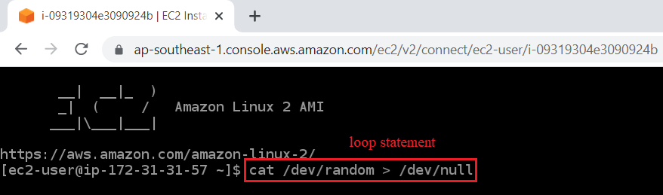
CloudWatch Service
Connect to instance & Using CPU
Loop statement: cat /dev/random > /dev/null
Waiting 10 minutes & View EC2 Statistics (EC2 Console)

Slide 8
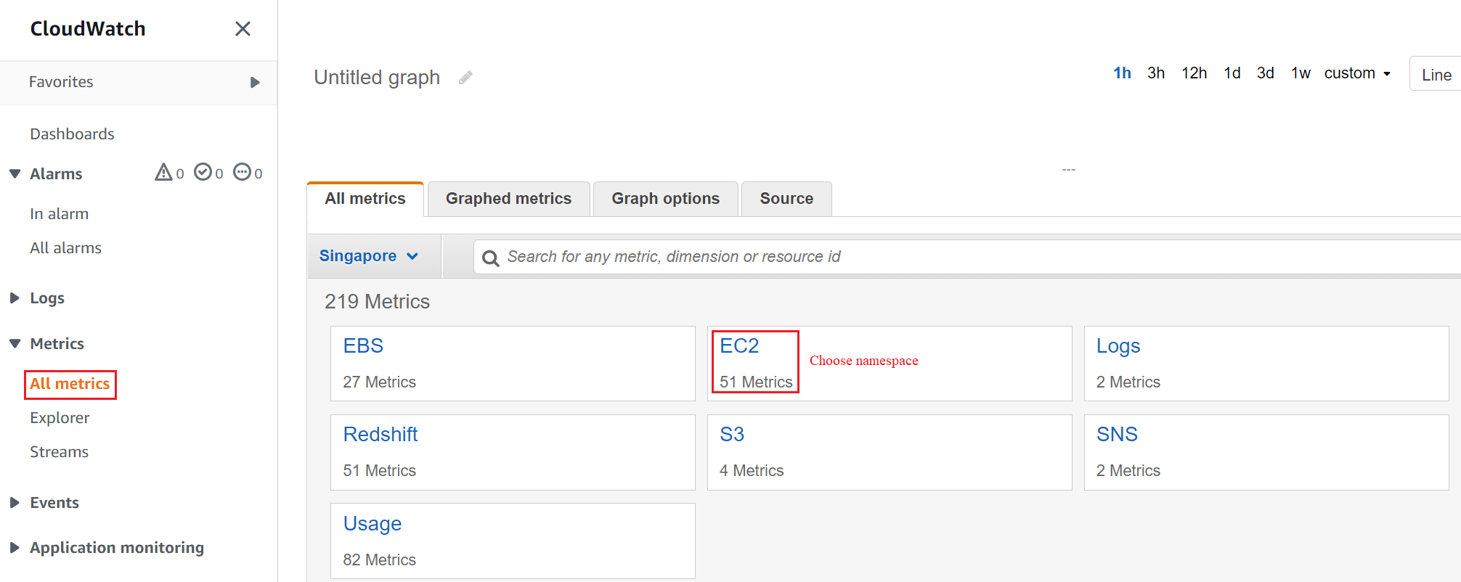
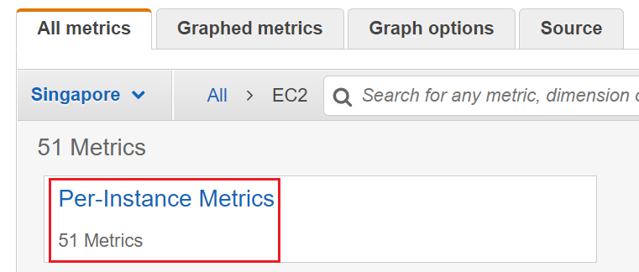
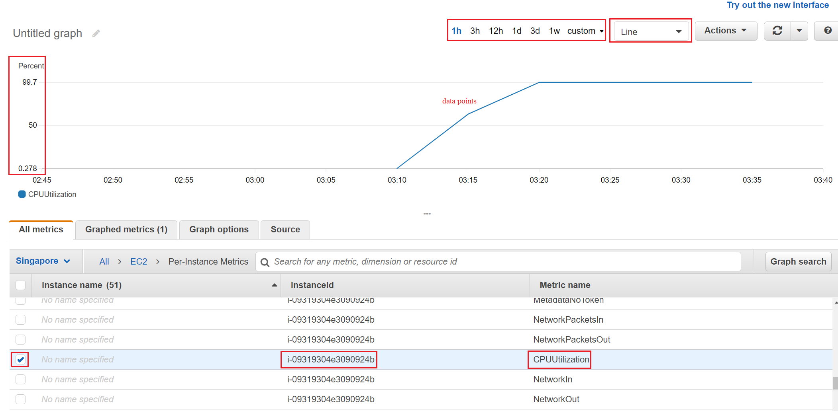
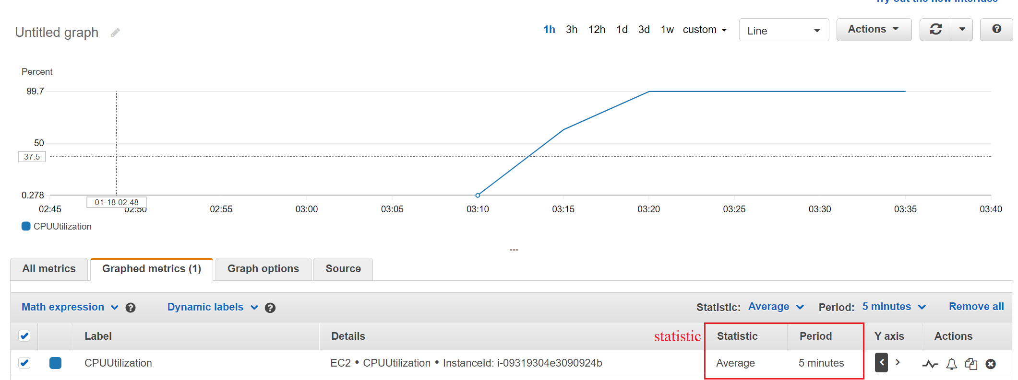
CloudWatch Service
View EC2 Statistics via CloudWatch Console
Choose namespace
Choose dimensions
Choose statistic

Slide 9
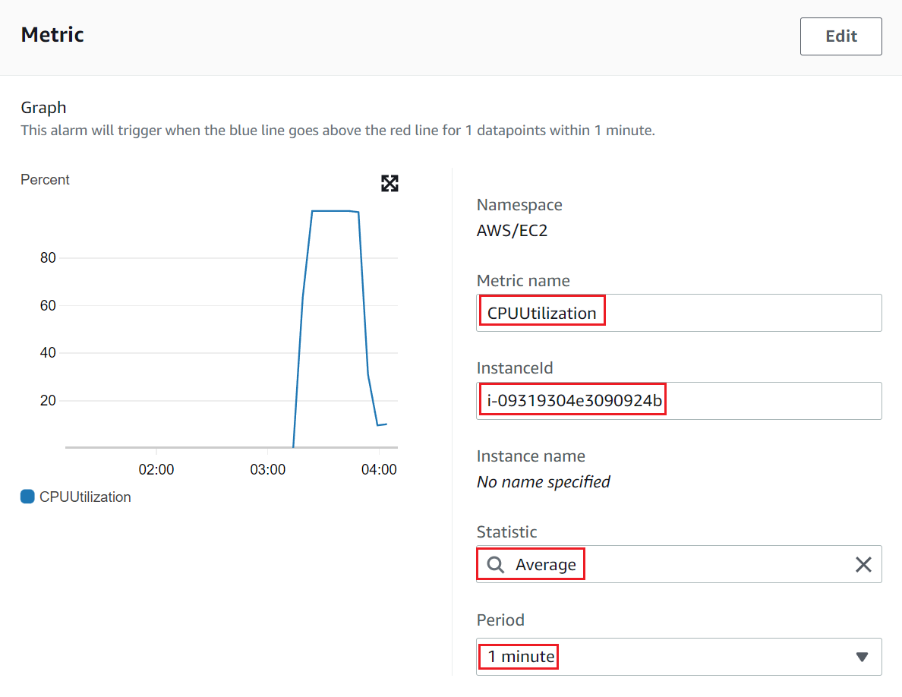
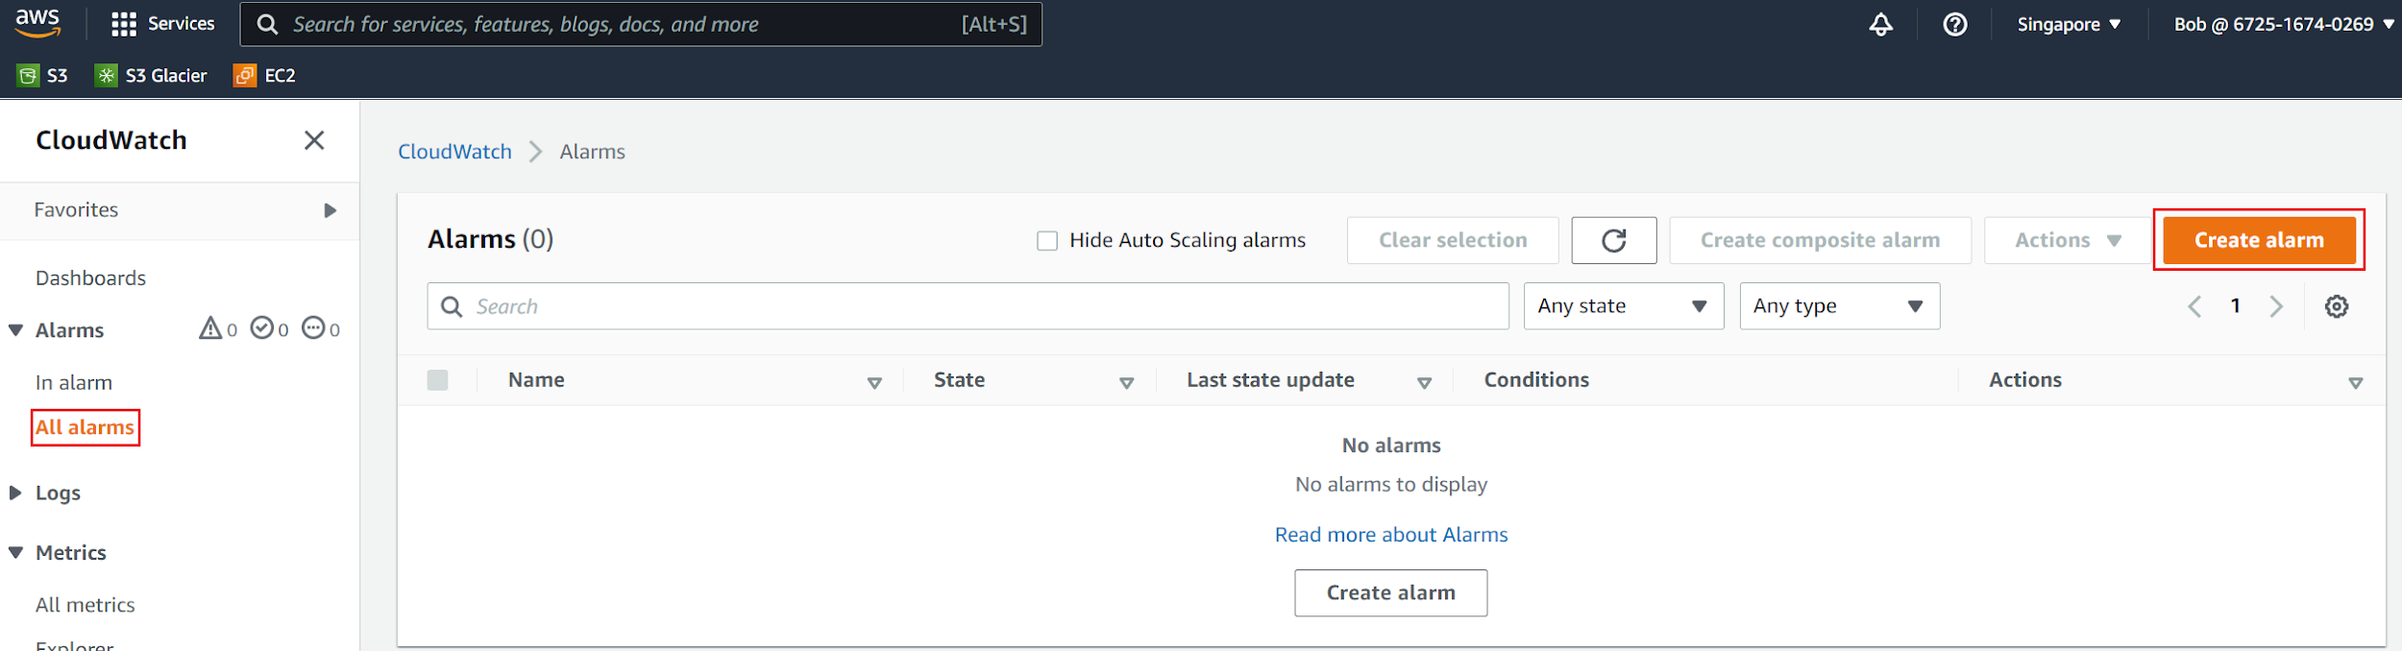
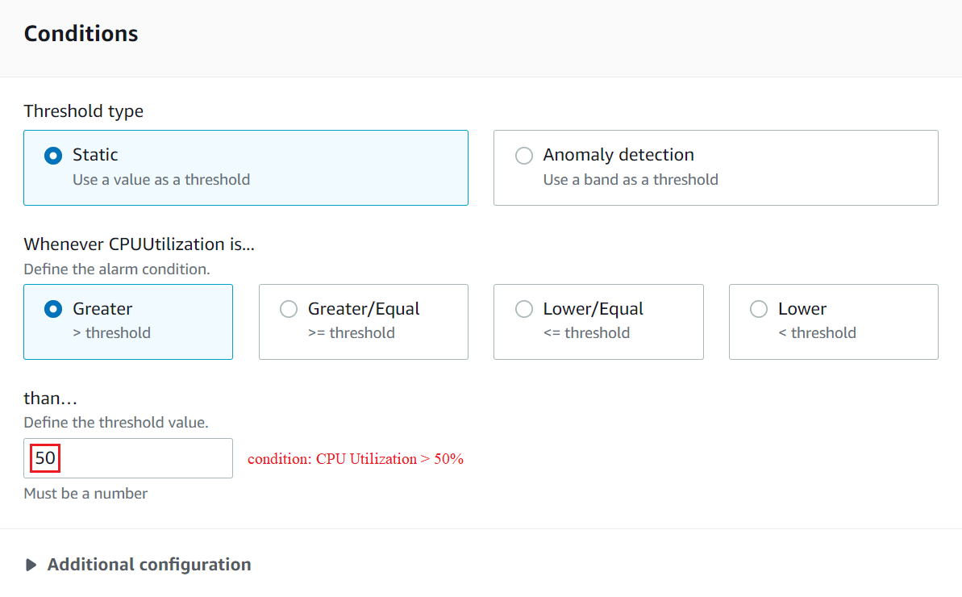
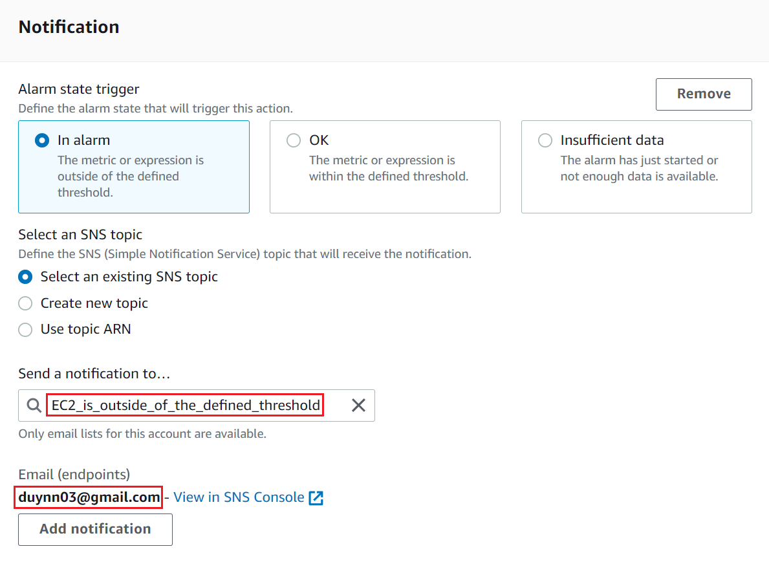
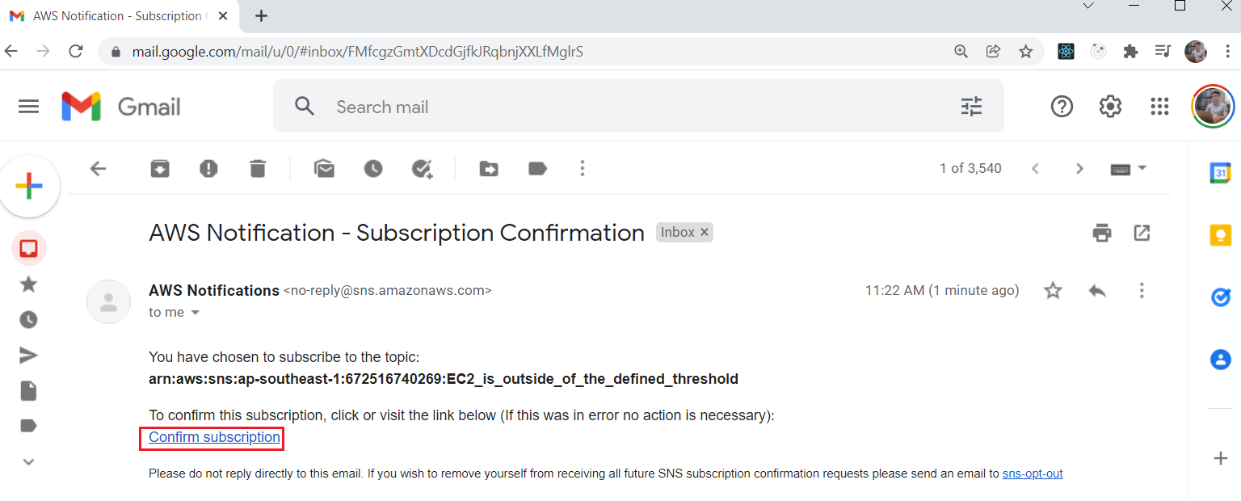
CloudWatch Service
Create Alarm
Choose metric
Choose condition
Setup Notification Action

Slide 10
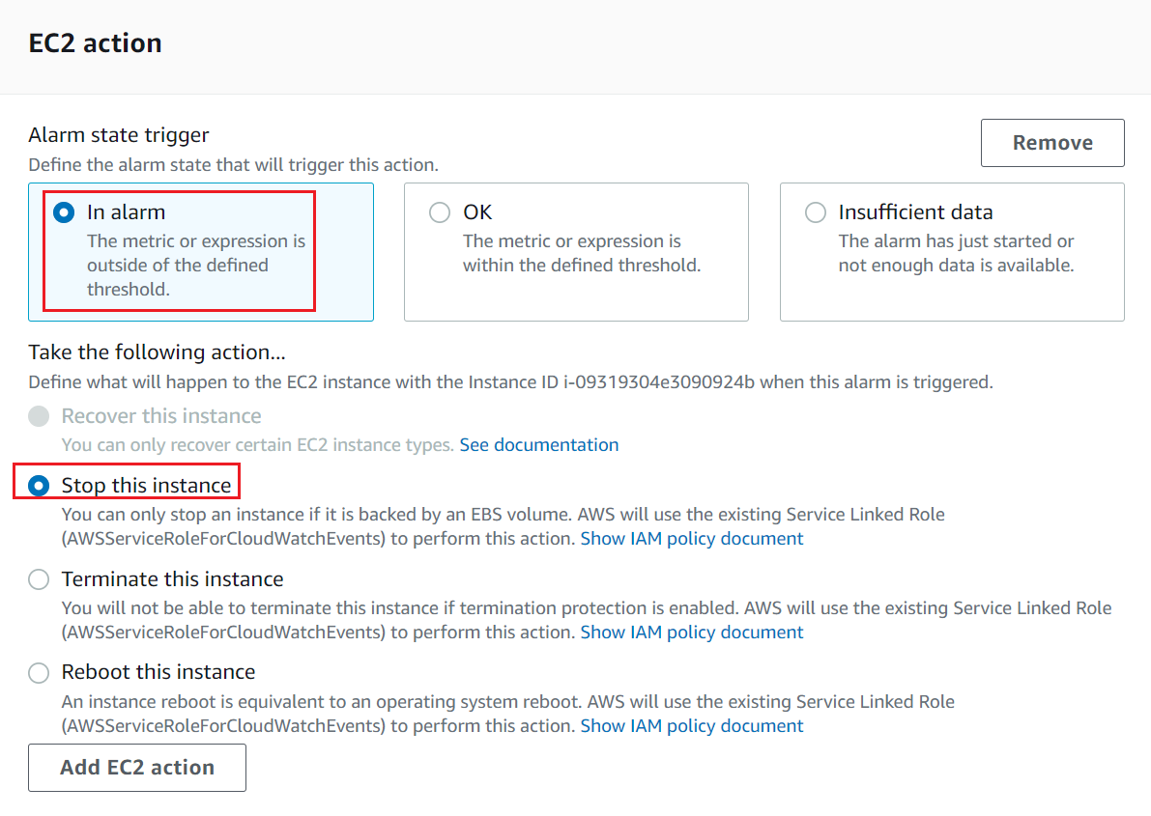
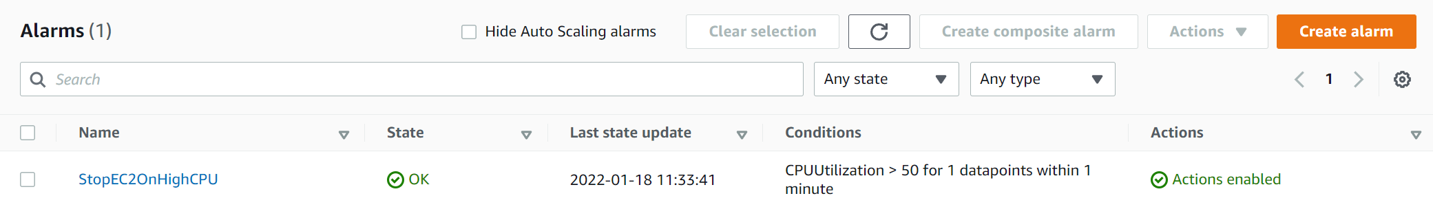
CloudWatch Service
Alarm
Setup EC2 Action
Restart EC2
Loop statement: cat /dev/random > /dev/null

Slide 11
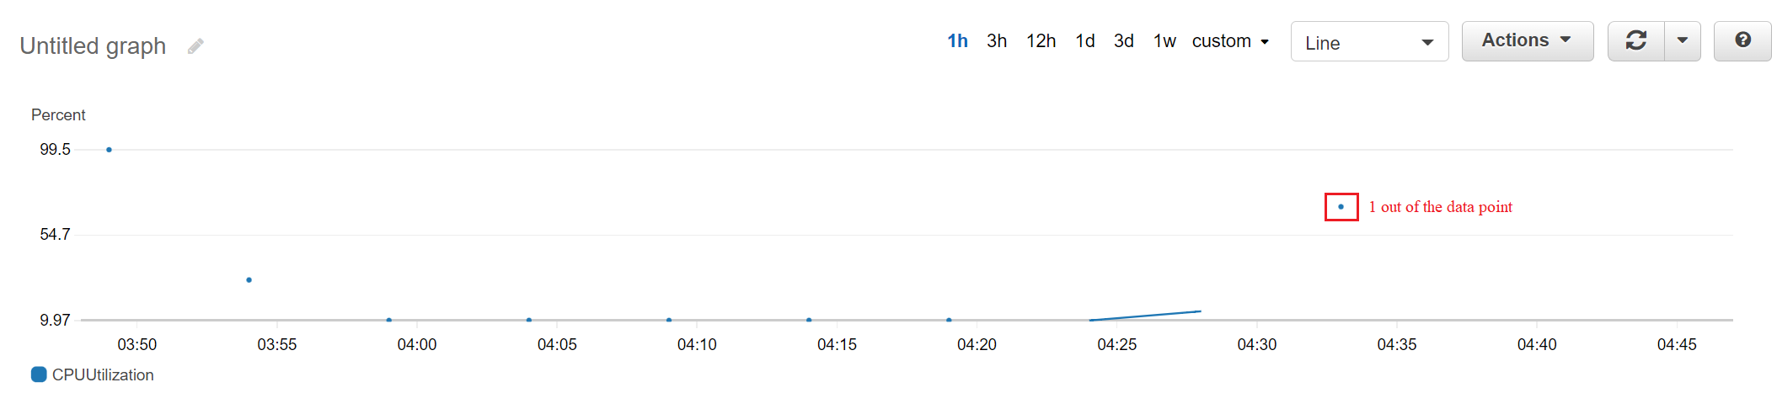
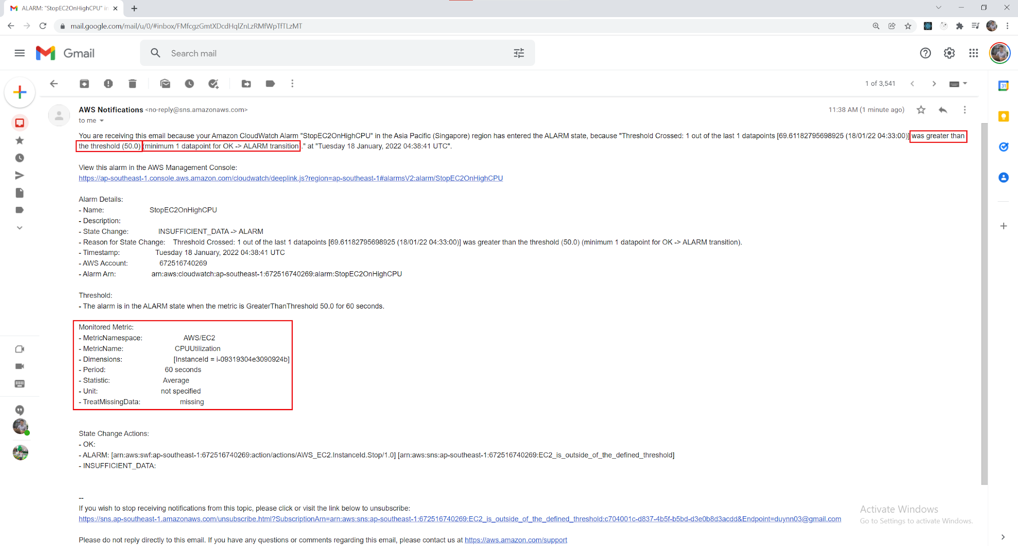
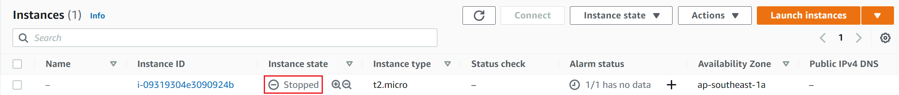
CloudWatch Service
Out of data points
EC2 action
Notification action

Slide 12
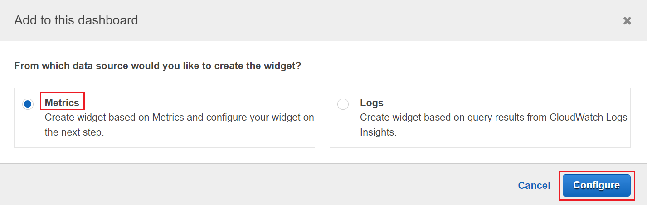
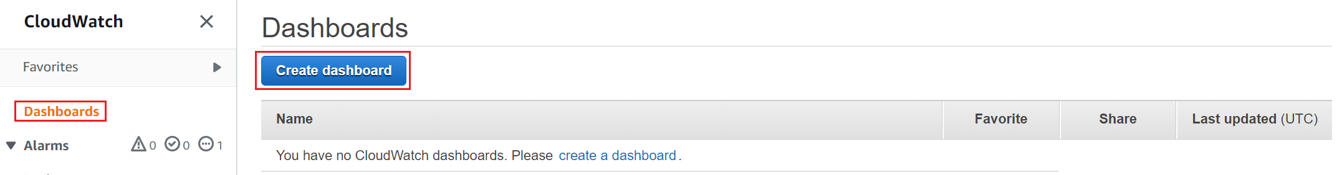
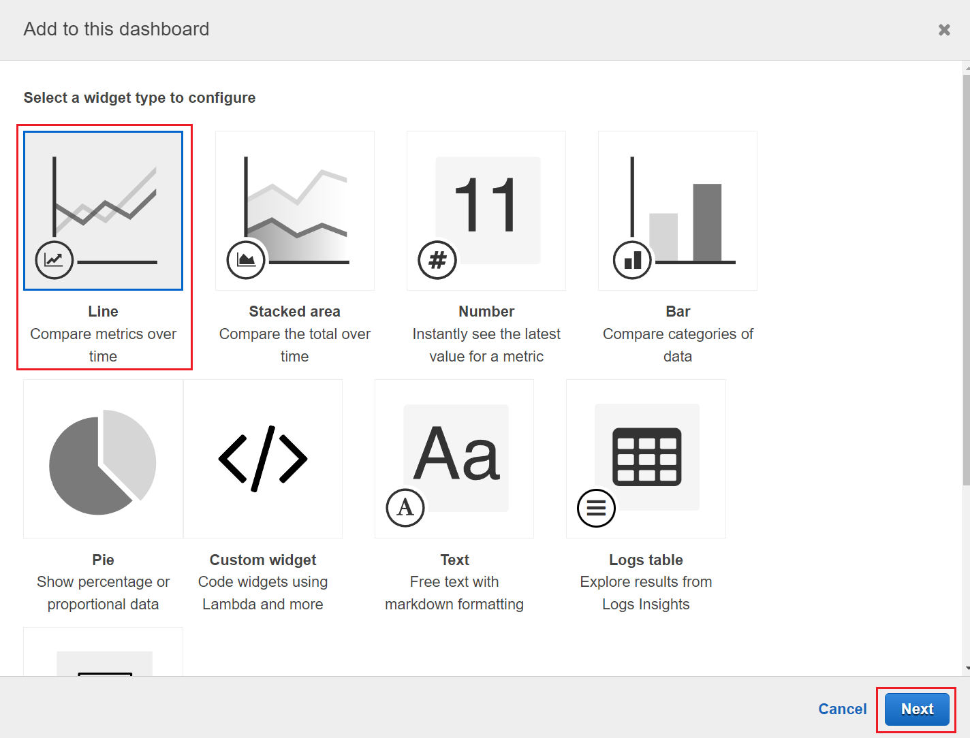
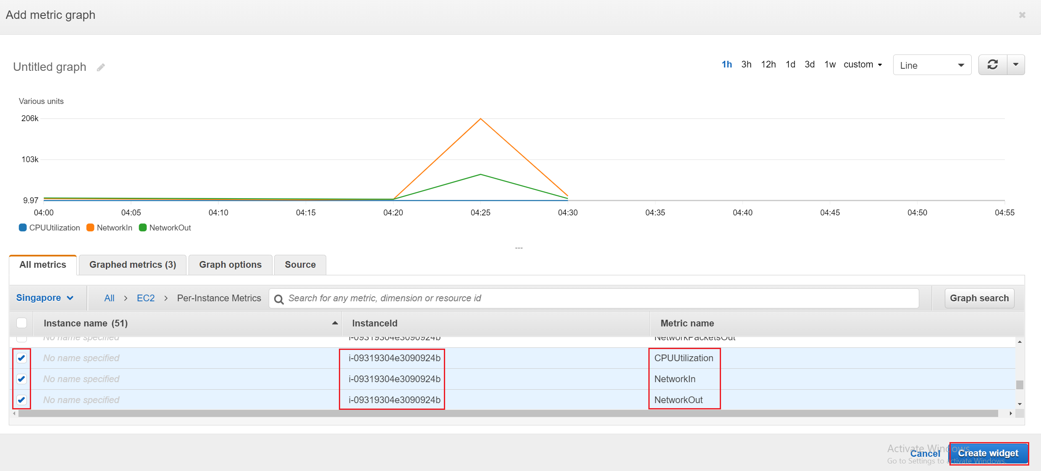
CloudWatch Service
Create Dashboard
Choose data source
Choose metric
Choose widget

Slide 13
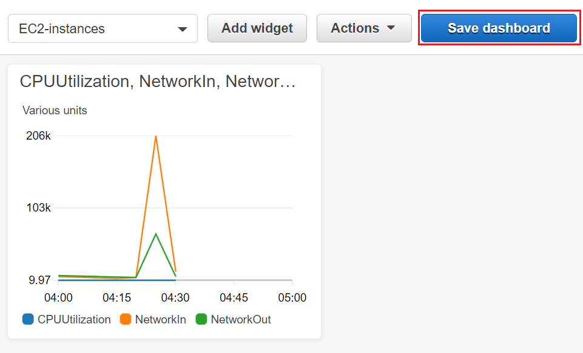
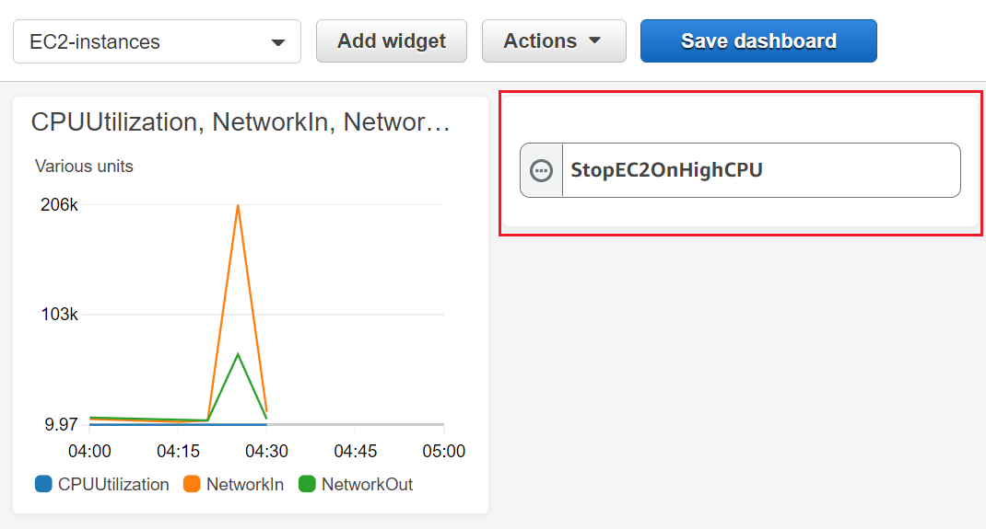
CloudWatch Service
Save dashboard
Choose other widget

Slide 14
Assignment
Self-practice

Slide 15
CloudWatch Service
Components
Metric
Alarm
Dashboard
Log
Event & EventBridge

Slide 16
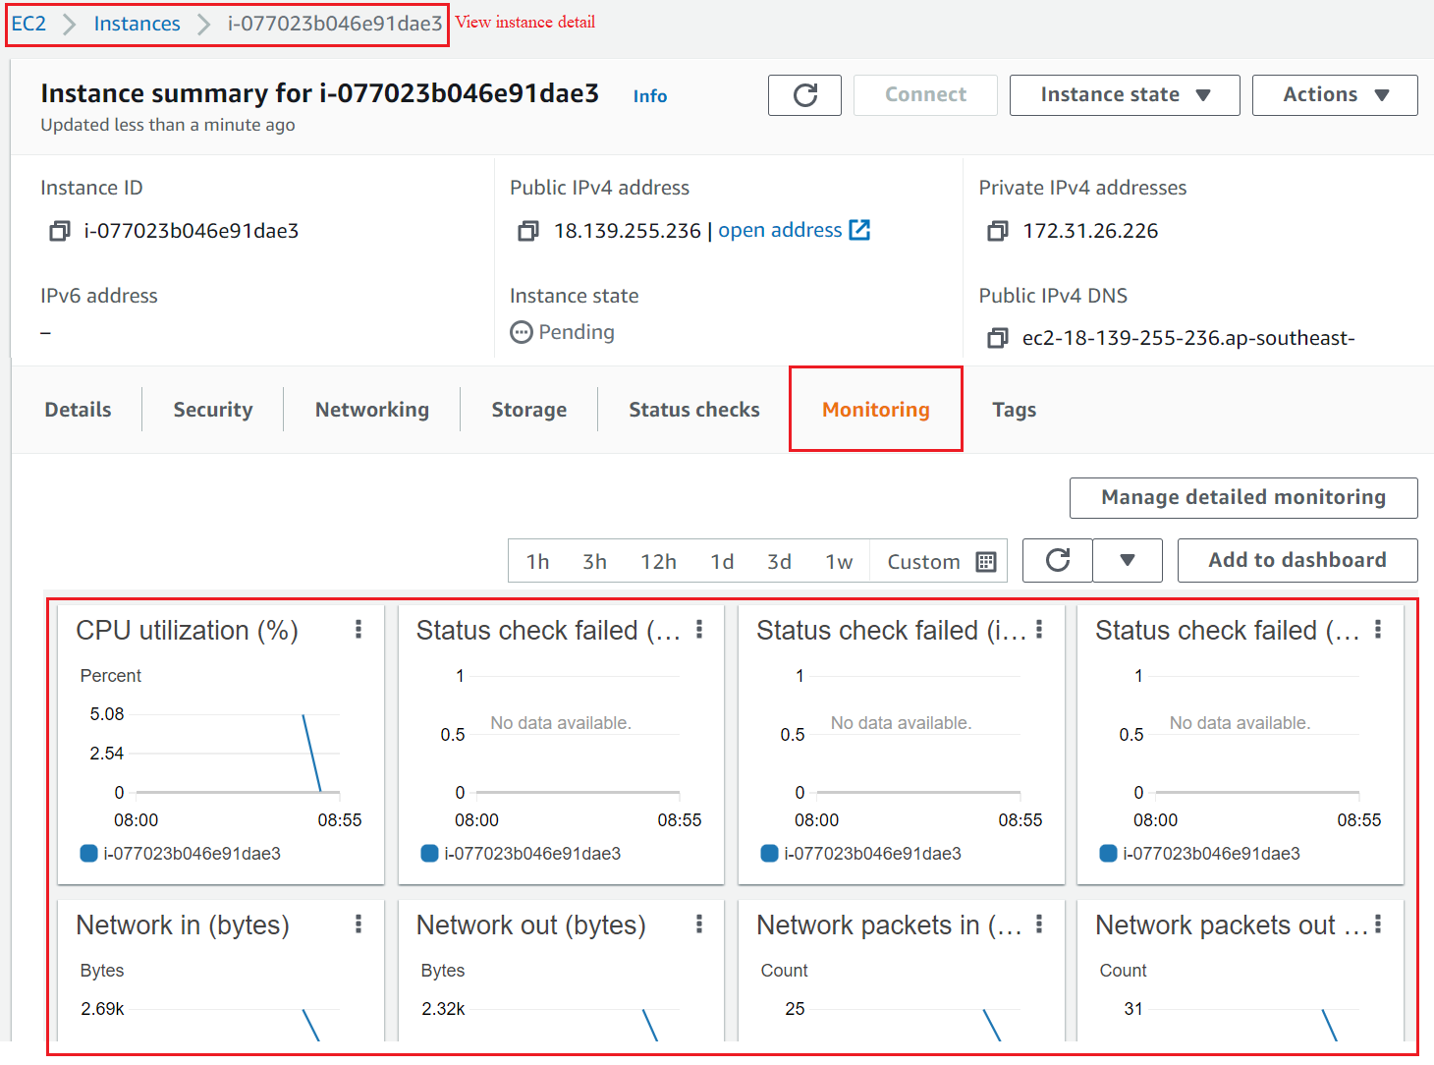
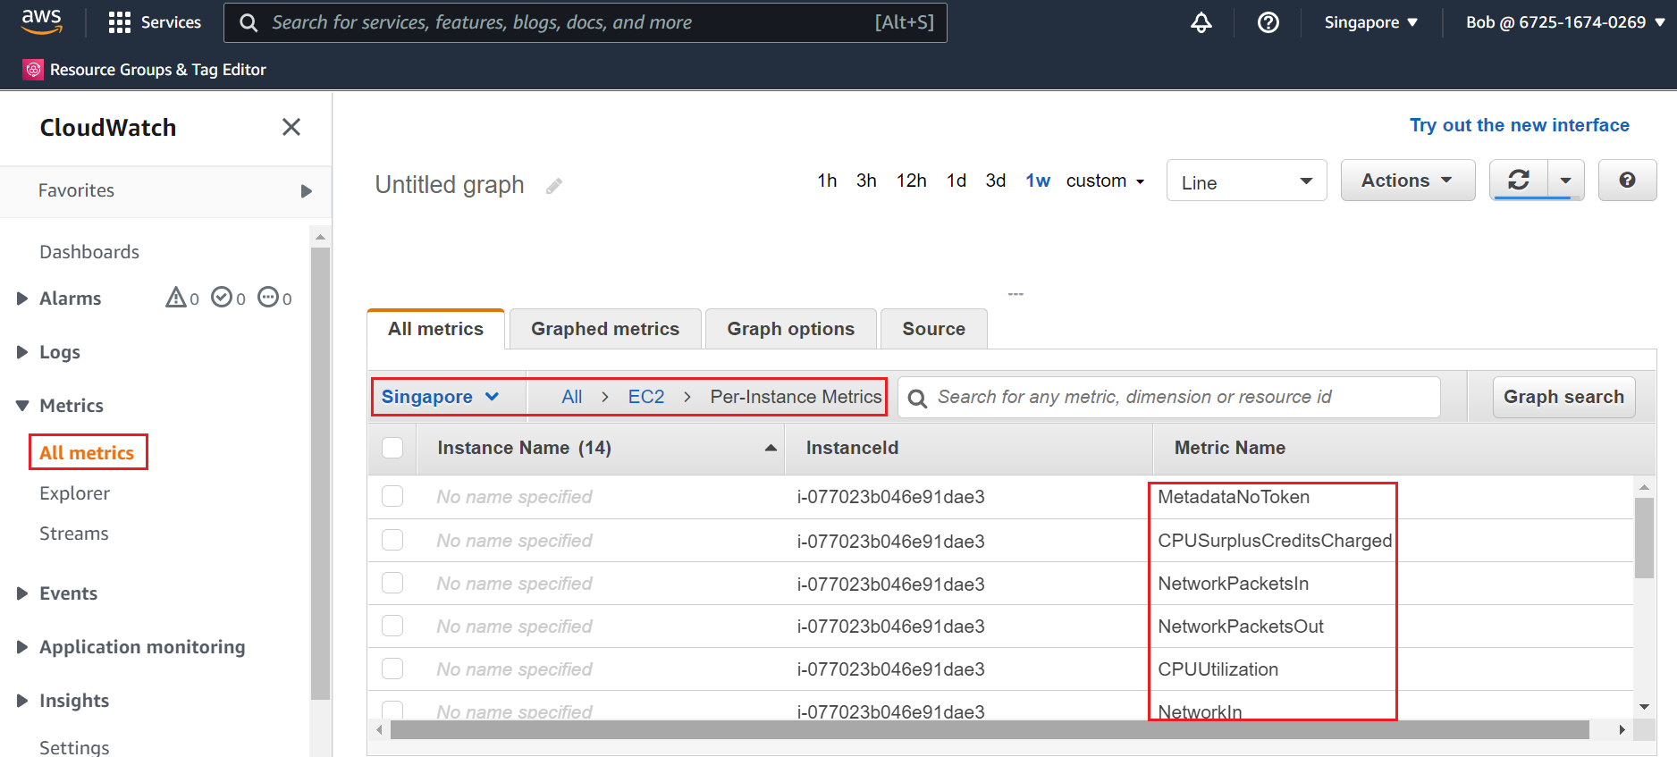
CloudWatch Service
Metric
Is a variable to monitor (CPUUtilization, NetworkIn…)
Regional resource
Support cross-account, cross-Region
Full service & Metric: https://docs.aws.amazon.com/AmazonCloudWatch/latest/monitoring/aws-services-cloudwatch-metrics.html

Slide 17
CloudWatch Service
Properties of metric
Name
Namespace
Dimensions
Data points
Statistic
Resolution

Slide 18
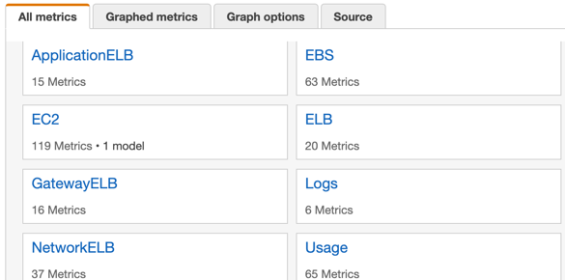
CloudWatch Service
Namespace
Is a container of metric (service name) that helps separate metrics of different services and applications
Available services are created in the form of AWS/service (Ex: AWS/EC2)

Slide 19
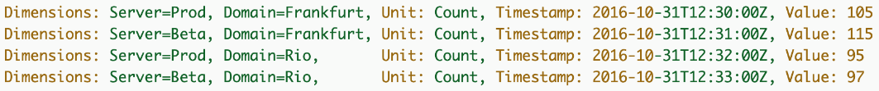
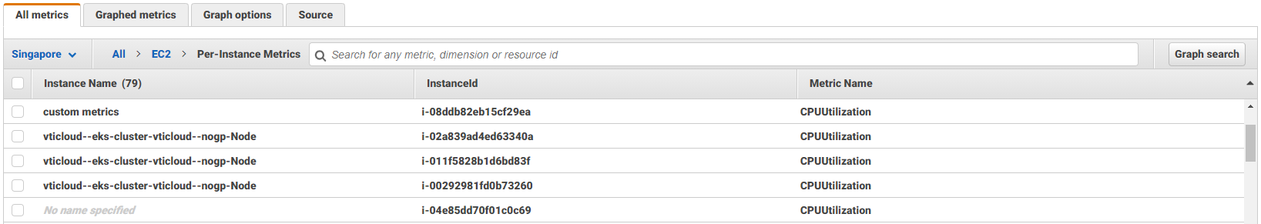
CloudWatch Service
Dimensions
Key-value format
Key: instance id, environment, …
Value: CPUUtilization, NetworkIn, NetworkOut, …
Max: 10 dimensions per metric

Slide 20
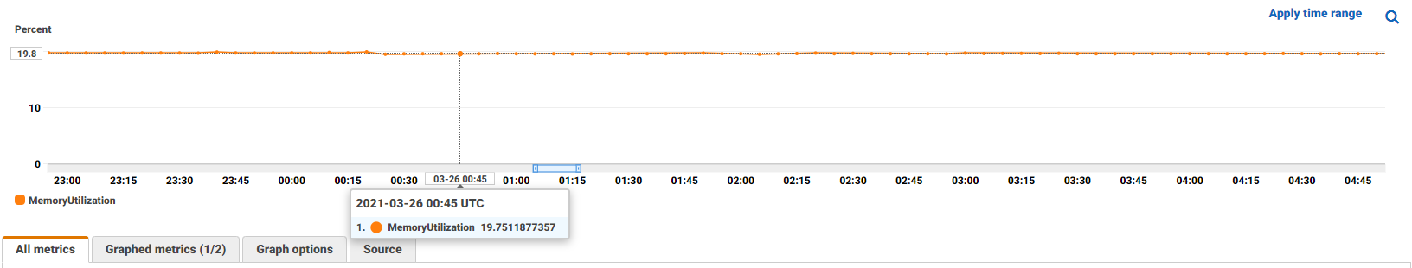
CloudWatch Service
Data points
Recorded by AWS
Each data point includes time stamp, unit (Bytes, Seconds, Count, %)

Slide 21
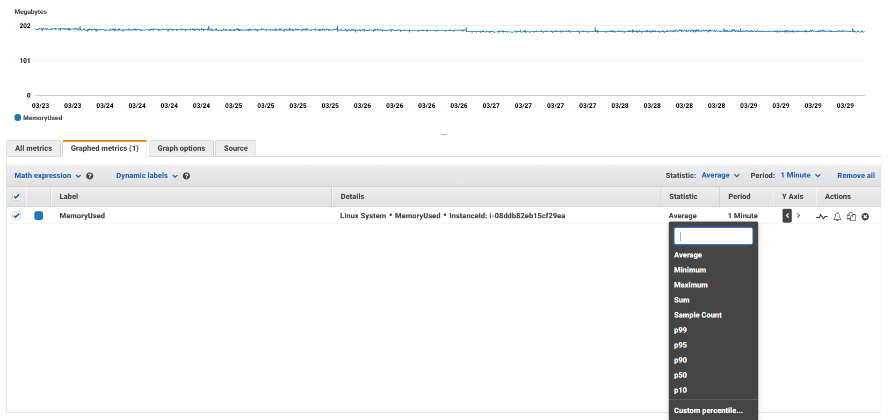
CloudWatch Service
Statistic
Aggregate data points over a period of time
Options: average, minimum. Maximum, sum, p99, p95, …
Period options: 1s, 5s, 10s, 1 minutes, … 30 day

Slide 22
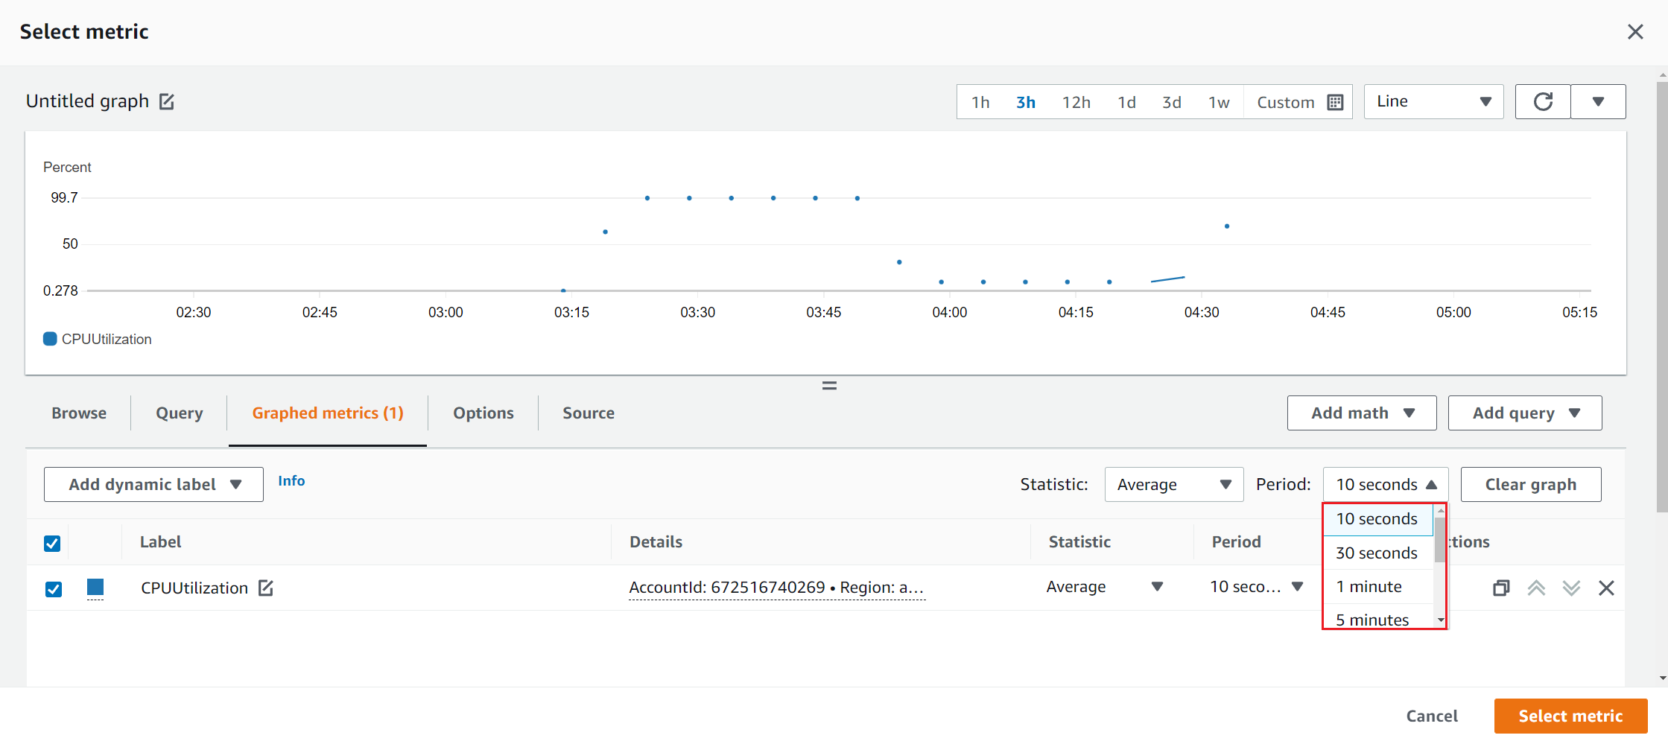
CloudWatch Service
Resolution
2 types
Standard resolution: Data is collected by the minute
High resolution: Data is collected by the second
EC2 instance metrics have metrics “every 5 minutes” - free
With detailed monitoring (for a cost), you get data “every 1 minute”
Free tier: 10 detailed monitoring metrics

Slide 23
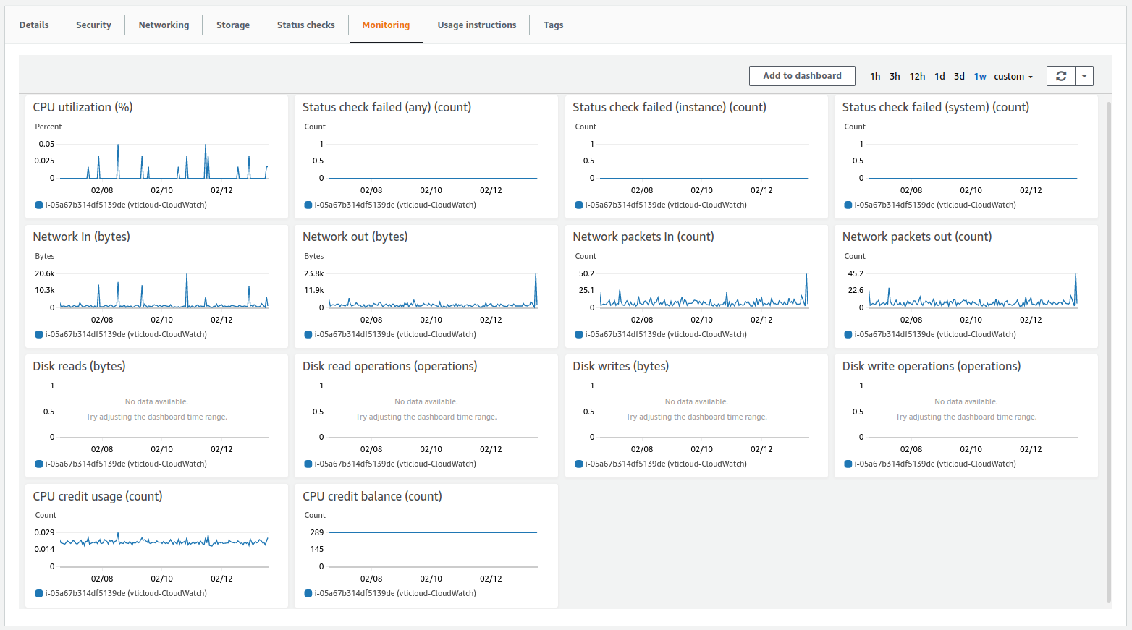
CloudWatch Service
2 types
Provided by AWS service
Free
Ex: EC2 instance, EBS, ..
Custom metric
Charge
Ex: number of logged in users
EC2 instances measure parameters related to Ram, CPU, Volume, Traffic, Status, ...
Custom metric tutorial: https://www.youtube.com/watch?v=kdyURQfLncY

Slide 24
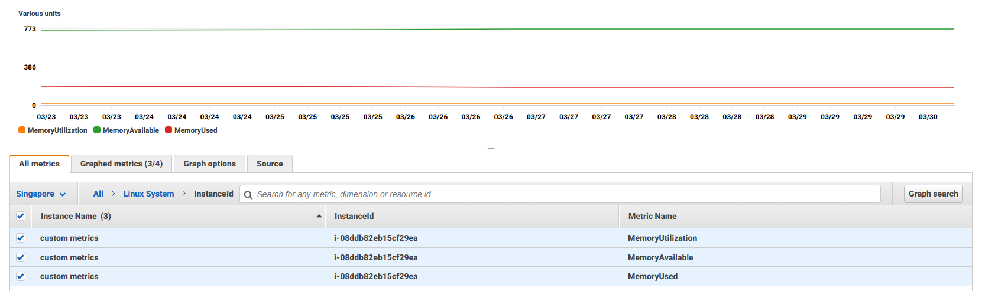
CloudWatch Service
Support metric for stream data (next lesson)
Cannot delete, automatically expires after 15 months with no data to push in

Slide 25
CloudWatch Service
Alarm
Take action when the metric reaches threshold
Usecases: Detect anomalies in the system
Components
Metric & Statistic, Period
Condition: Threshold, Data points to alarm, Missing data treatment
Action: SNS, EC2 instance, Auto scaling action, Lambda function, …
State: INSUFFICIENT_DATA, OK, ALARM
Notification action
EC2 action

Slide 26
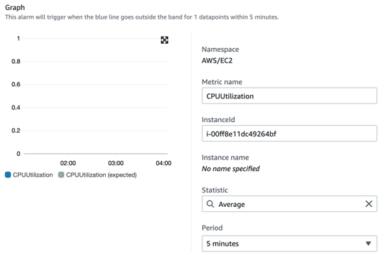
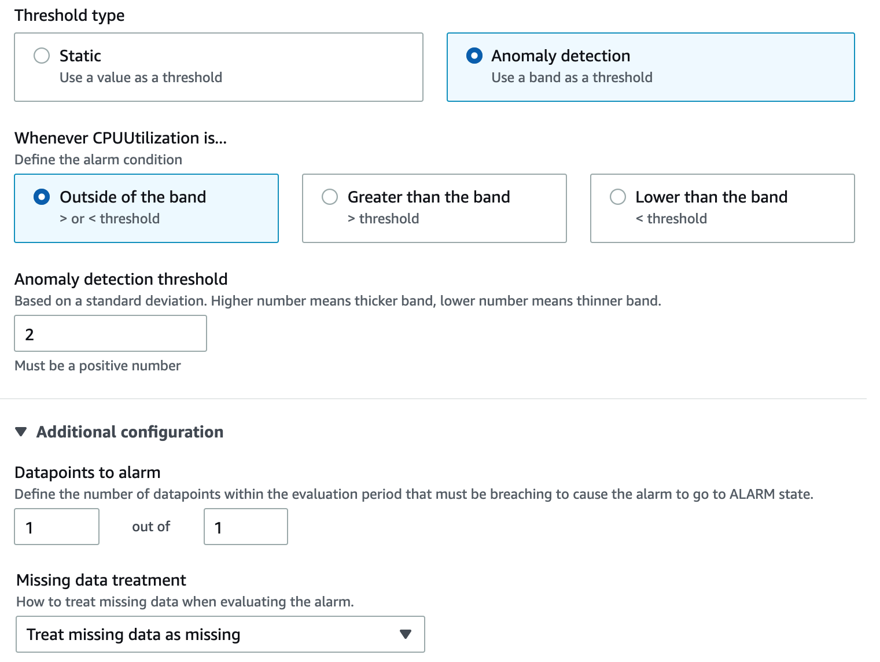
CloudWatch Service
Metric & Statistic, Period
Condition

Slide 27
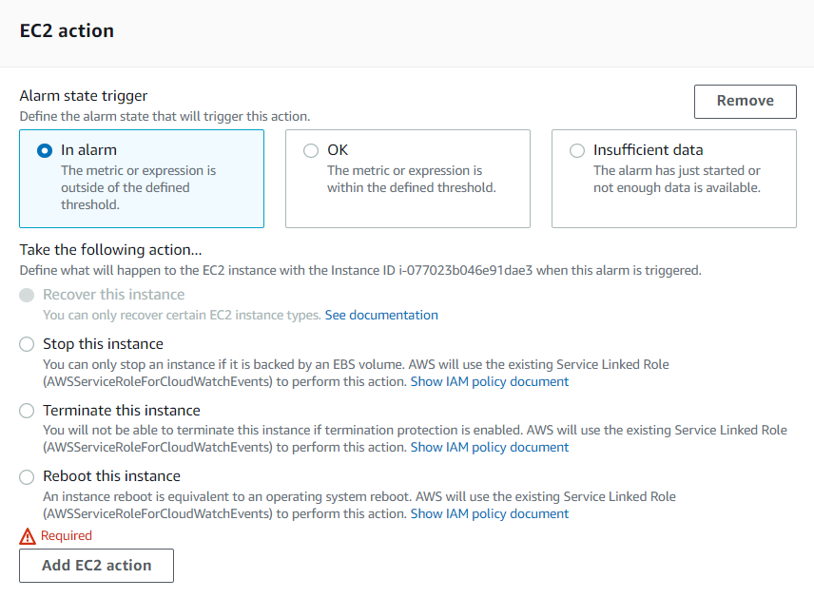
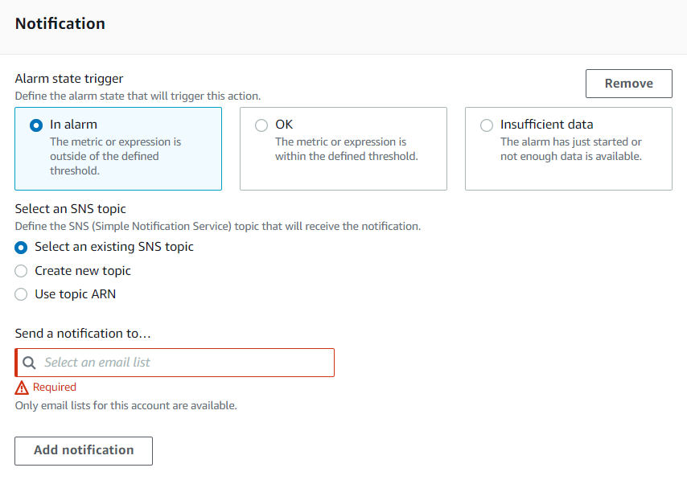
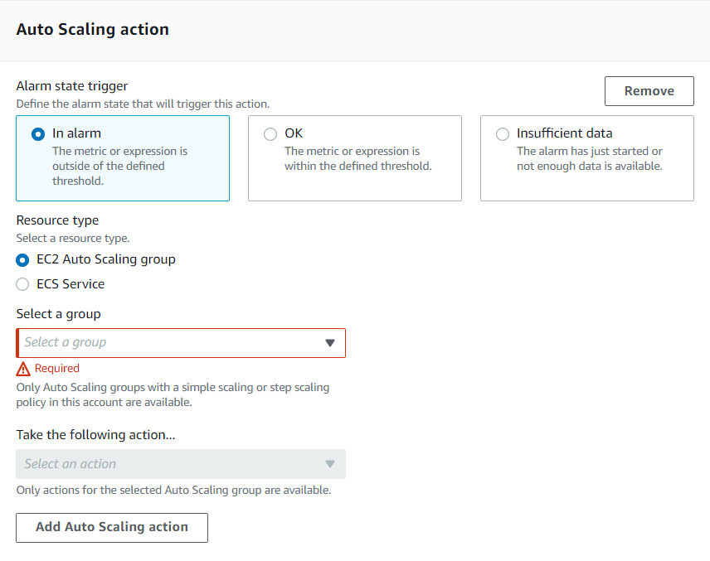
CloudWatch Service
EC2 action
Notification action
Auto scaling action

Slide 28
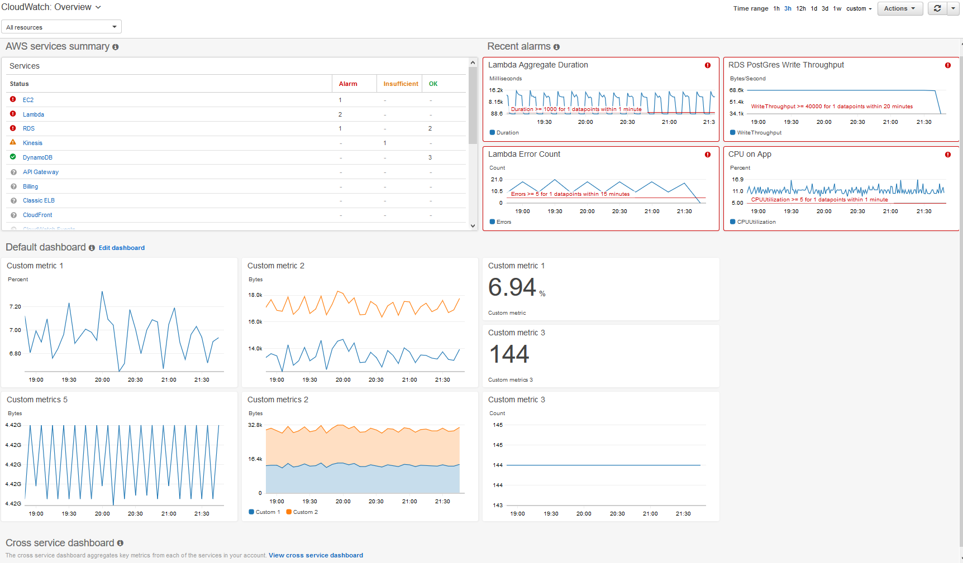
CloudWatch Service
Dashboard
Display resources in global (different regions & accounts)
You can setup automatic refresh (10s, 1m, 2m, 5m, 15m)
Dashboards can be shared with people who don’t have an AWS account (public email address)
Up to 50 dashboards
Free tier: 3 dashboards

Slide 29
CloudWatch Service
Log
Monitor, save, access, and centrally manage logs from AWS resources & Application runs on AWS (Ex: EC2 instance, CloudTrail, Route 53, ...)
Features
Monitor log from EC2 instance
View, Search, Filter directly the fields of the application's log without ssh into the instance
Query on log data
Visualize log data in dashboards
Demo: https://www.youtube.com/watch?v=F4IE69V-iuw

Slide 30
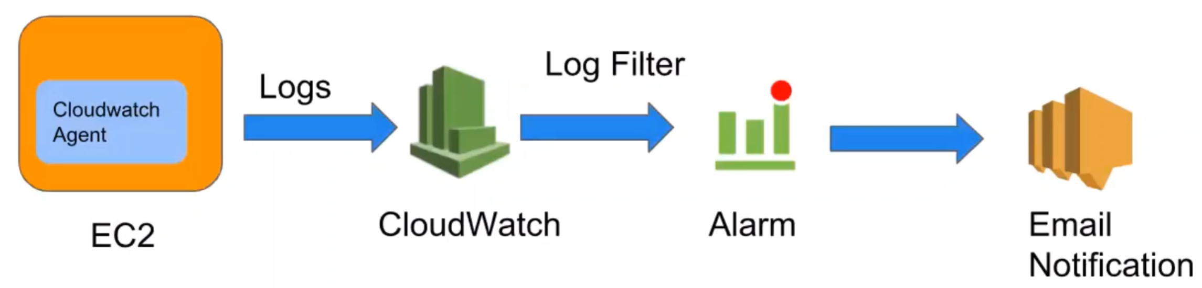
CloudWatch Service
Components
Source
Target
Metric Filter & Insights

Slide 31
CloudWatch Service
Sources
SDK, CloudWatch Logs Agent, CloudWatch Unified Agent
Elastic Beanstalk: collection of logs from application
ECS: collection from containers
AWS Lambda: collection from function logs
VPC Flow Logs: VPC specific logs
API Gateway
CloudTrail based on filter
Route53: Log DNS queries

Slide 32
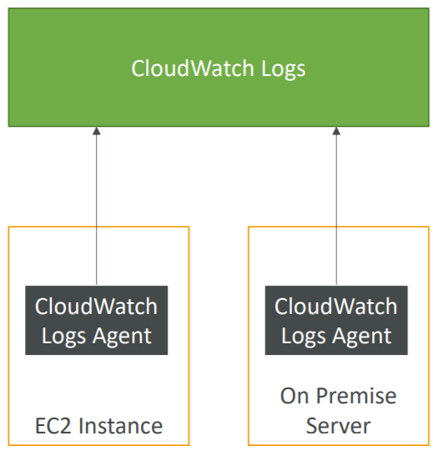
CloudWatch Service
CloudWatch Logs Agent
Setup for virtual servers (Ex: EC2 instances, on-premises servers)
By default, no logs from your EC2 instances will go to CloudWatch 🡺 setup CloudWatch agent on EC2 to push the log files
Attach IAM Role
Old version of the agent
CloudWatch Unified Agent
Collect additional system-level metrics such as RAM, CPU, Disk, …

Slide 33
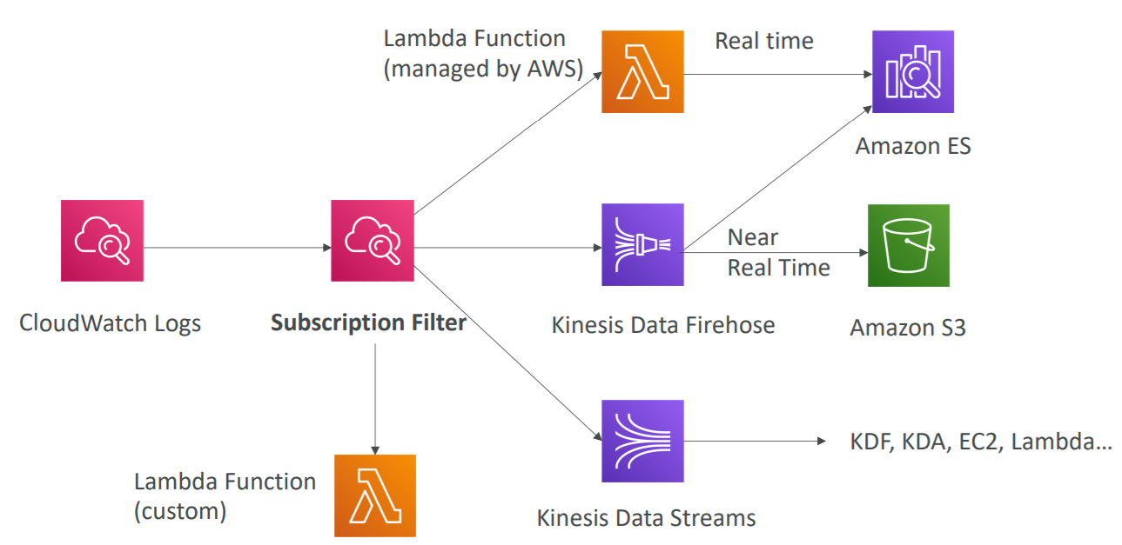
CloudWatch Service
Target
Export to S3
Kinesis Data Streams, Kinesis Data Firehose
Lambda function
ElasticSearch

Slide 34
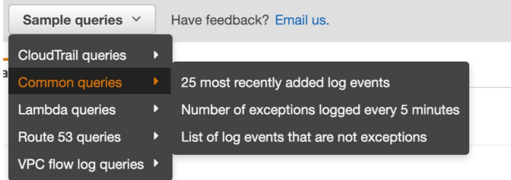
CloudWatch Service
Metric Filter
Used to filter expressions (Ex: find a specific IP inside of a log, count occurrences of “ERROR” in your logs)
Can be used to trigger the Alarm
Metric Filter Insights
Used to query logs and add queries to Dashboards

Slide 35
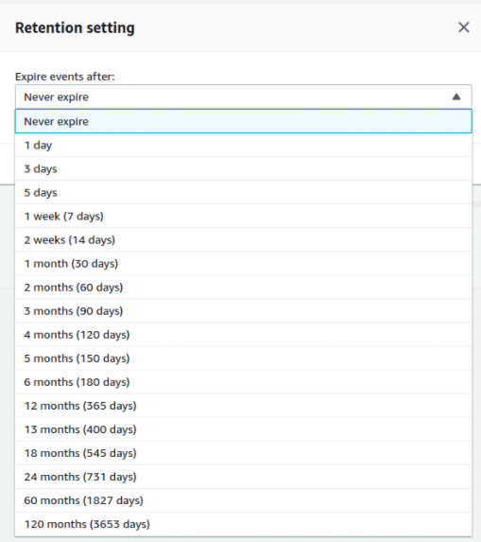
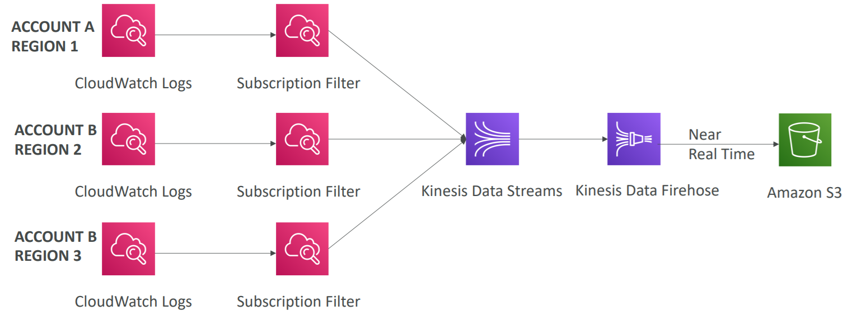
CloudWatch Service
Can define log expiration policies (never expire, 30 days, ..)
Support Multi-Account & Multi Region

Slide 36
Assignment
Self-practice

Slide 37
CloudWatch Service
Event
Setup rule to match AWS resources Event and target functions
Demo
Create SNS
Create Rule
Test

Slide 38
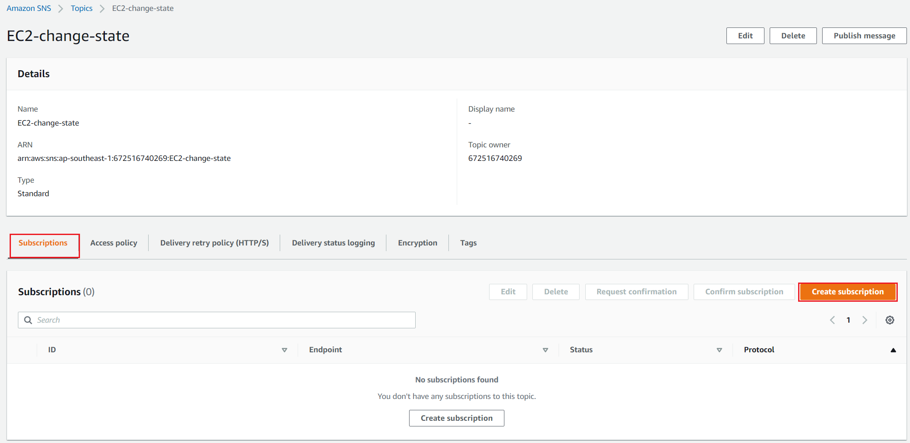
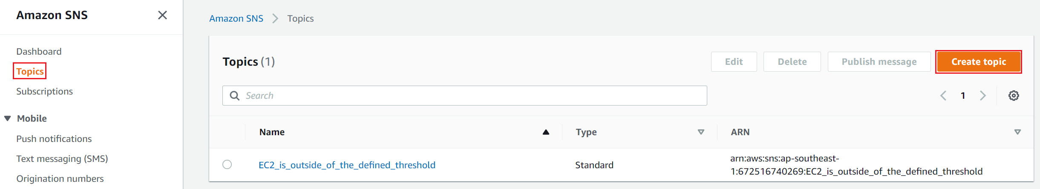
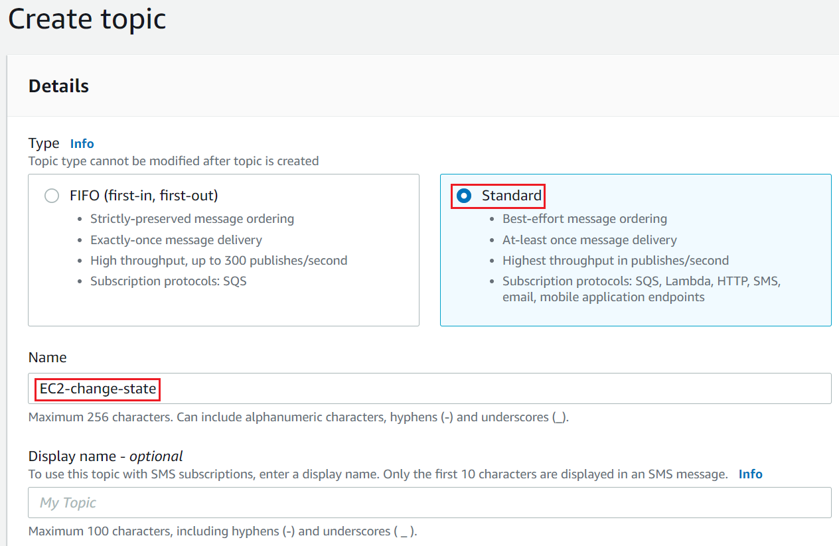


CloudWatch Service
Create SNS
Create topic
Create subscription

Slide 39




CloudWatch Service
Create Rule

Slide 40


CloudWatch Service
Test
Launch new instance
Email

Slide 41
CloudWatch Service
Components
Source
Target

Slide 42


CloudWatch Service
Source
Events from AWS services (Ex: EC2 Instance Start, CodeBuild Failure, S3, …)
Schedule, Cron (Ex: create an event every 4 hours)
The default event bus of another AWS account
Schedule & Cron
Event pattern

Slide 43

CloudWatch Service
Target
Send email, reboot, stop instances, …
Target

Slide 44

CloudWatch Service
EventBridge
Is the new version of CloudWatch Events
Demo: https://www.youtube.com/watch?v=ea9SCYDJIm4

Slide 45
Assignment
Self-practice

Slide 46
Q & A
Copyright © VTI Academy All Rights Reserved

